Slide 1
Woodland Public Schools
Facilities and Safety Report
April 2021

Slide 2
FACILITIES REPORT
Summer planning is shifting into high gear as we near the end of the year. We will be able to focus more on the exterior surfaces of the building, as the interior surfaces of the building saw less wear and tear due to remote learning.
The Yale backup water pump was again delayed, as the supplier, Gould Pump is struggling with their suppliers trying to get materials to their factory. Mather and Sons Pump was able to find another pump in the Portland area that is a close match. It will be temporarily installed until the correct pump can be received. With Gould's current manufacturing delays, I would expect the permanent replacement mid-summer.
In light of rolling to phase 3, the District is now able to let community members start renting interior school facilities. This will be tied to the phased reopening (Healthy Washington Roadmap to Recovery), plus additional steps for patrons using the facilities to comply with Covid rules and procedures.
After six years of trying, we are finally getting an inspection at all the schools with the county fire inspector. I had requested this starting in 2017 only to find that there was no budget to support it. We welcome this activity as it helps identify potential fire risk across the District.
Still trying to wrap my hands around what the PPE requirements will look like going into the 21-22 school year. We currently have enough supplies to last well into the first few months of the new school year. Hopefully, the case counts and spread will continue to spiral down as more folks get vaccinated, and we return to a more normal school year!

Slide 3
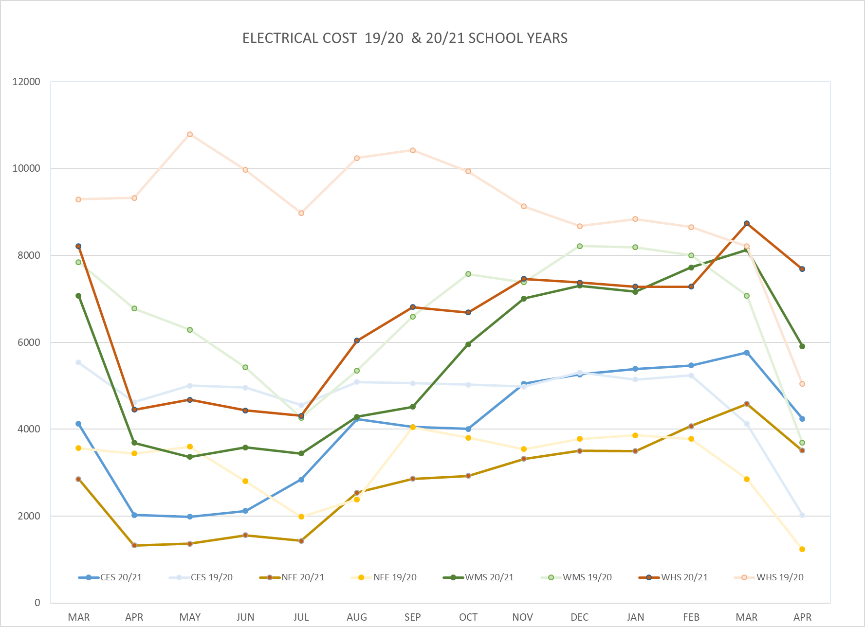
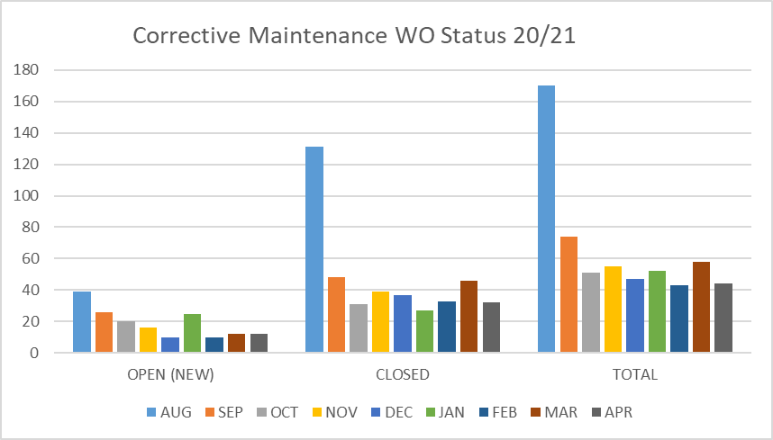
FACILITY CHARTS – POWER COST AND WORK ORDER STATUS

Slide 4
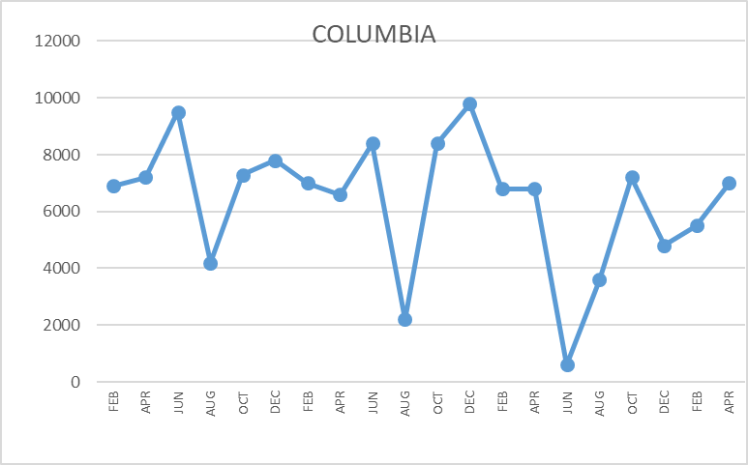
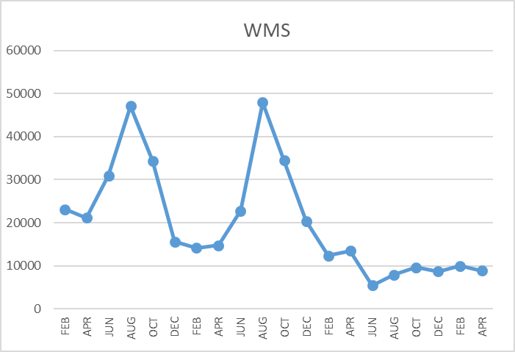
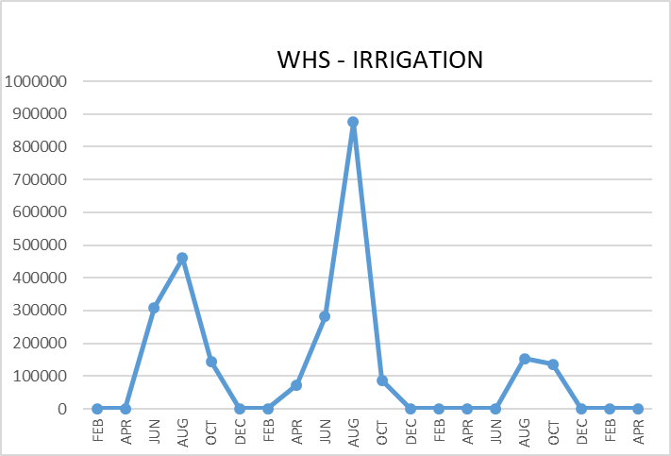
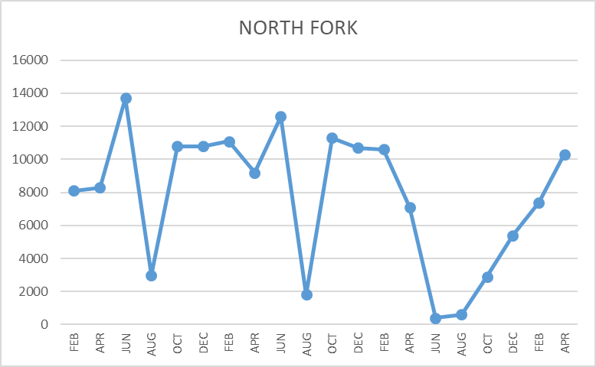
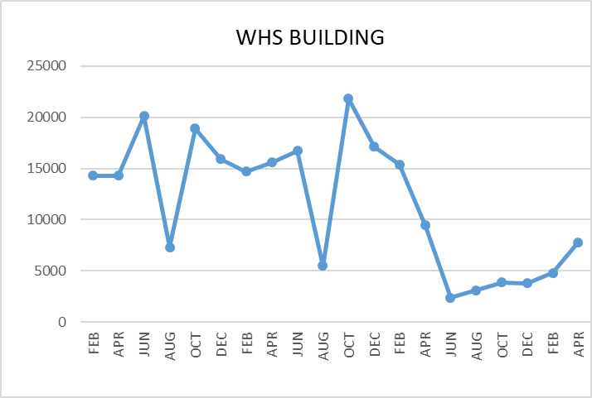
FACILITY CHARTS WATER USAGE WHS, NFE, WMS, CES
Note
Water charts are updated every two
months. Next update to these charts in the June 2021 report
The WMS chart includes the following 7 meters: 755 Park high and low flow, BO and Team High, PIT house, bus barn, athletic field and DO. All of these meters are totaled on the WMS graph, but each data point is recorded separately to aid in identifying leaks.

Slide 5
Safety Summary
Staff Accidents/Incidents
None reported.
Student Accidents/Injuries
WMS- Student tripped while playing tennis, landed poorly-fractured wrist.
WMS- Student fell and struck head while playing basketball-concussion.
WMS- Student sprained knee while doing basketball drills.
WMS- Student fell while playing basketball-bruised left arm.
WMS- Student hit in head with basketball-concussion.

